Slide 1
UT Arlington

Slide 2
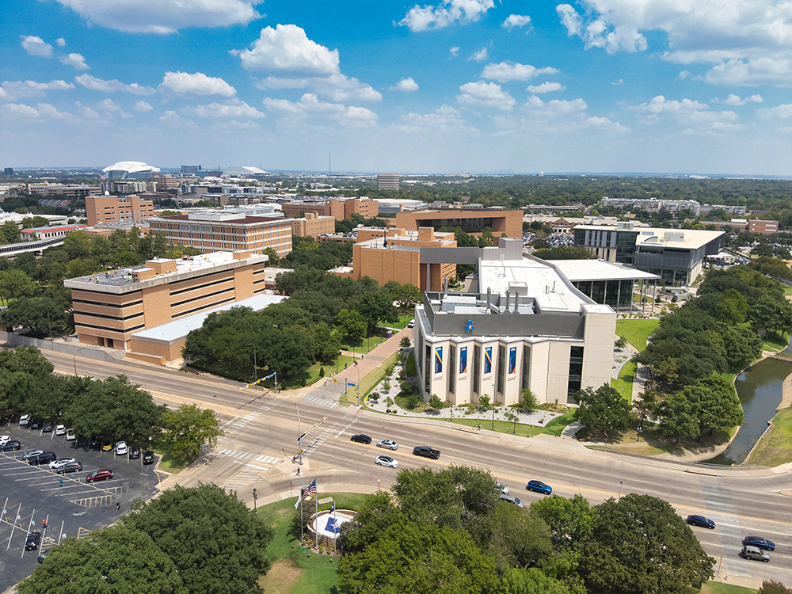
UTA at a Glance
The University of Texas at Arlington is a comprehensive research, teaching, and public service institution whose mission is the advancement of knowledge and the pursuit of excellence.
Founded in 1895
Campuses in Arlington and Fort Worth
Second-largest UT System university

Slide 3
UTA By the Numbers
9 colleges and schools
180-plus degree programs
41,000-plus enrollment
Students from over 100 countries
Over 13,000 degrees awarded annually
One of only 171 universities named to Phi Theta Kappa Transfer Honor Roll
No. 6 for undergraduate ethnic diversity (U.S. News & World Report, 2025)
No. 1 public university for veterans in nation (Military Times, 2023)
No. 1 in North Texas for social mobility (U.S. News & World Report, 2025)
No. 1 university in DFW (The Wall Street Journal, 2025)
18 graduate programs ranked as “Best Graduate Schools” by U.S. News & World Report

Slide 4
Research
Carnegie Research-1 designation.
In 2024, research expenditures topped $155 M.
UTA’s research portfolio is anchored by five strategic pillars: health and the human condition, sustainable communities, global environmental impact, data-driven discovery, and culture and societal transformations.
Faculty work in state-of-the-art facilities to make important breakthroughs in areas such as sustainable infrastructure, healthy aging, high-energy physics, cardiovascular disease, machine-learning systems, and more.

Slide 5
Alumni Impact
UTA has 270,000-plus living alumni.
79% live in Texas, 62% in North Texas.
UTA graduates earn highest first-year median wage of any academic UT System institution.
UTA and its alumni create a $29 billion annual economic impact in state of Texas.

